Slide 1
Pressure Sensor Measurement Website User Manual
Presenter：Juan Anthonio Salas
Date：2026/01/23

Slide 2
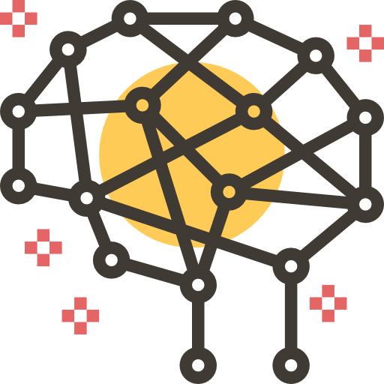


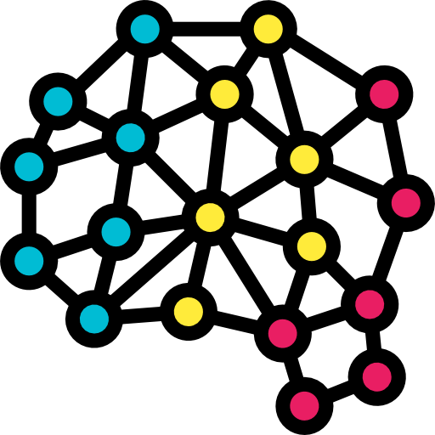

What is Pressure Sensor Measurement System ?
Pressure Sensor Measurement System is a pressure measurement system designed to acquire and display pressure data in real time using a pressure sensor connected to a computer via USB or Bluetooth.
This system is intended for testing, monitoring, and pressure data analysis, and it supports interactive graphical visualization to facilitate real-time observation and post-measurement evaluation.

Slide 3
What the library need to install ?
To run the Pressure Sensor Measurement System properly, the following software and libraries are required :
Backend Environment
Python 3.9 – 3.11 (tested on Python 3.10)
Required Python Libraries:
Fastapi, uvicorn, ps02usb (for USB communication), ps02 (for Bluetooth communication), numpy, asyncio, websockets, pyserial, bleak==2.1.1
Frontend Environment
Node.js 18.x or later, npm 9.x or later

Slide 4
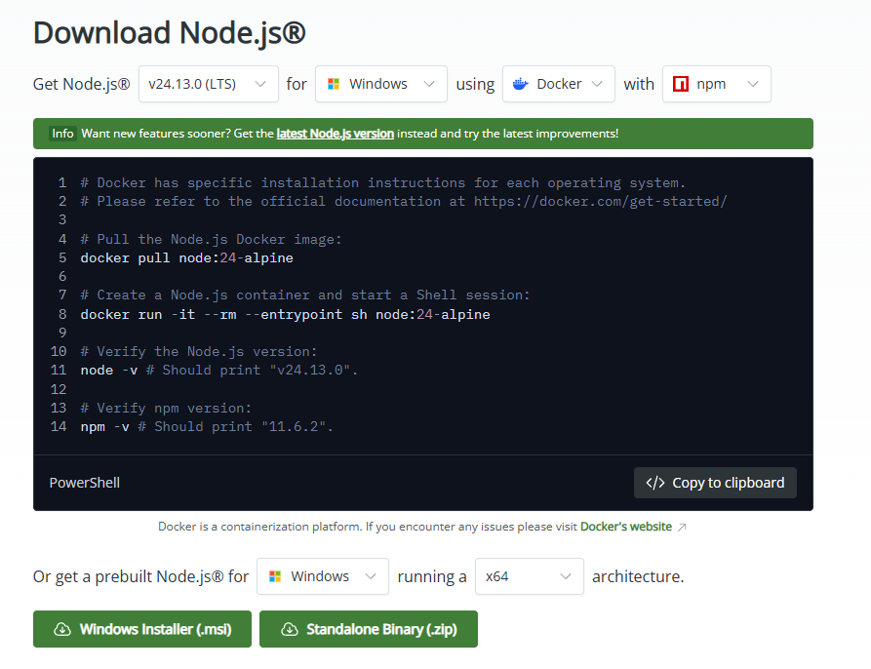
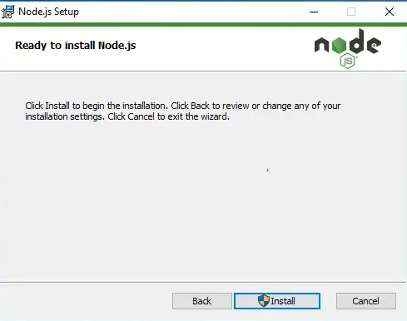
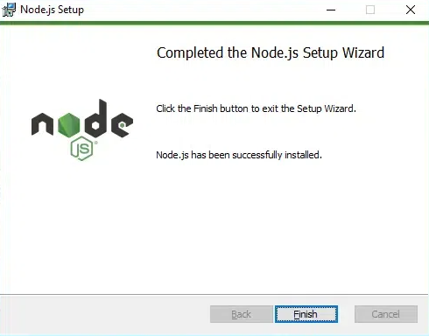
Installation Guide – Front-end (1)
Open a web browser and visit the official Node.js website: https://nodejs.org
Download the LTS (Long Term Support) version
Run the installer and follow the installation steps
Keep the default settings during installation
Select “Install” to complete the process
Wait for "Finish" to complete the setup
Download button

Slide 5
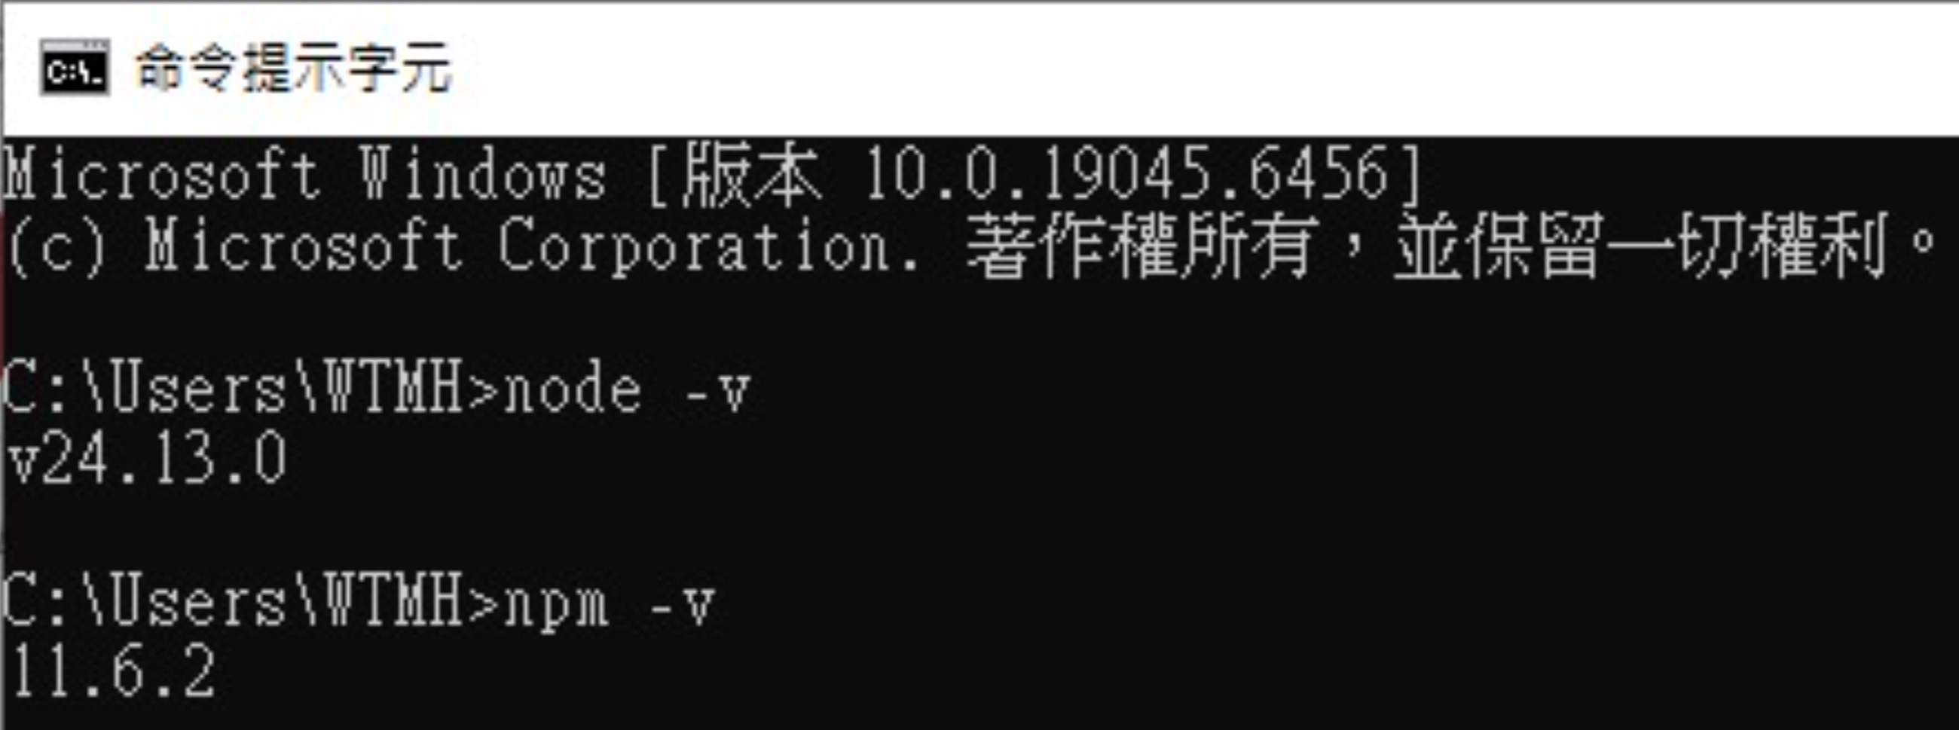
Installation Guide – Front-end (2)
Verify Node.js and npm Installation
Run the following commands:
node -v
npm -v
Version numbers should be displayed, indicating a successful installation

Slide 6
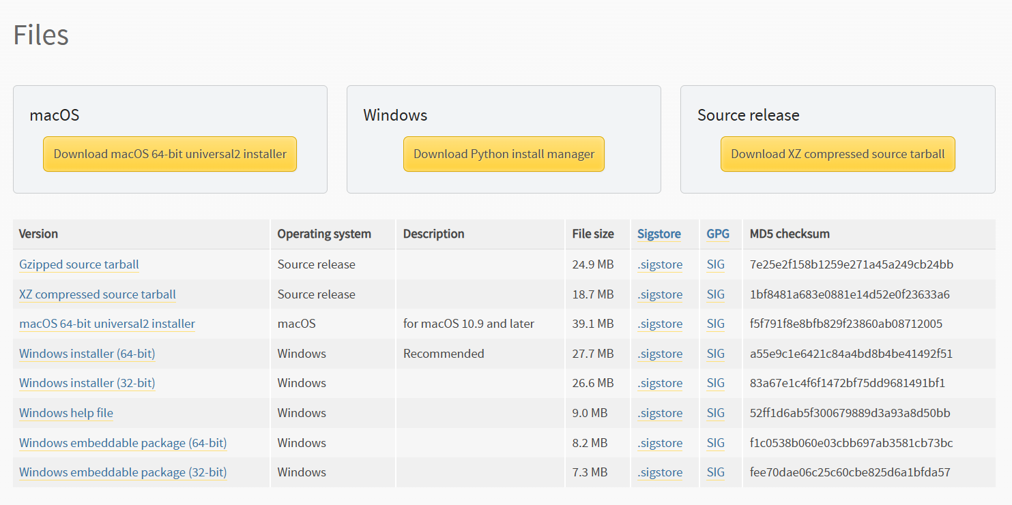
Installation Guide – Back-end (1)
Open a web browser and visit the official Python website:
https://www.python.org
Download Python version 3.10.11 (recommended)
Within this link https://www.python.org/downloads/release/python-31011/
Download button

Slide 7
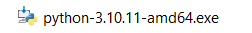
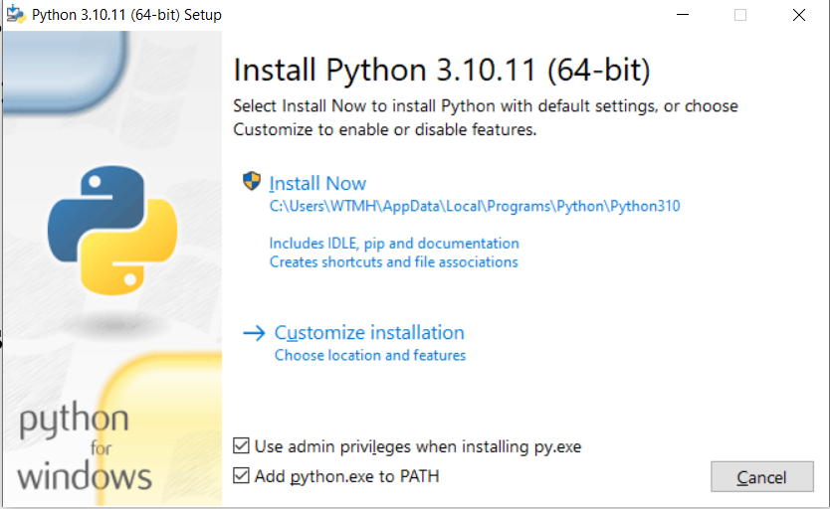
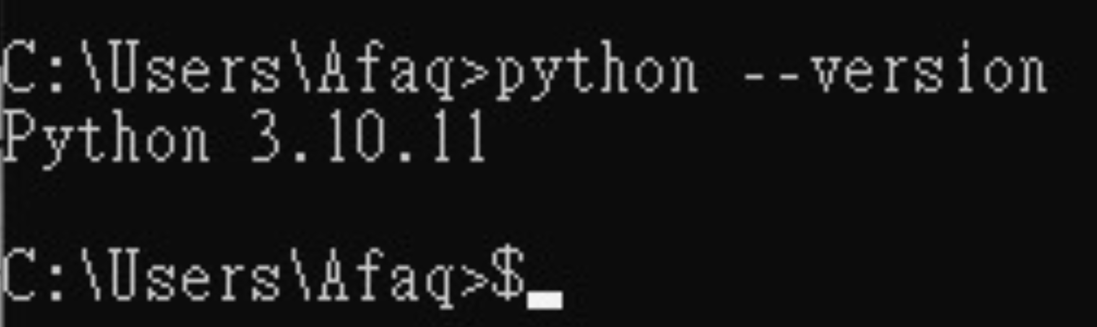
Installation Guide – Back-end (2)
1.Run the Installer
2. Check the option “Add Python to
PATH” before clicking Install
3. Install Now
Don’t forget verify the version of your python using this command on your command prompt python --version
The system has been tested on Python 3.10.11

Slide 8
Installation Guide – Back-end (3)
Install the required libraries using the following command:
Install FastAPI
python -m pip install fastapi
Install Uvicorn
python -m pip install uvicorn
Install NumPy
python -m pip install numpy
Install WebSockets
python -m pip install websockets
Install PySerial
python -m pip install pyserial
Install Bleak Library
python -m pip install bleak

Slide 9
Installation Guide – Back-end (4)
After installation please verify that all required libraries are installed correctly by running the following command in the terminal:
python -c "import fastapi,uvicorn,numpy,websockets,serial,blake; print('OK’)”
If the output is OK with no errors, it confirms that all dependencies are installed and accessible in the current Python environment

Slide 10
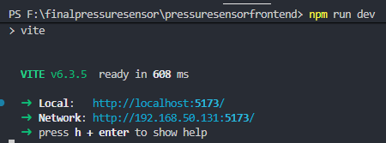
How to run Front-end ?
Steps to Run the Front-end
Open a terminal
Navigate to the front-end directory (pressuresensorfrontend)
Start the frontend development server: npm run dev
Once started, the terminal will display an address similar to: Local: http://localhost:5173
The front-end port must be running on port 5173 / http://localhost:5173

Slide 11
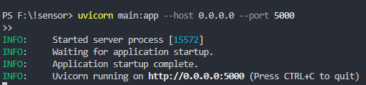
How to run Back-end ?
Steps to Run the Back-end
Open a new terminal window
Navigate to the backend directory (pressuresensor)
Start the backend server: using this uvicorn main:app --host 0.0.0.0 --port 5000
Ensure the backend is running successfully. The terminal should display a message similar to:
Uvicorn running on http://0.0.0.0:5000
Application startup complete
The back-end port must be running on port 5000 / http://0.0.0.0:5000

Slide 12
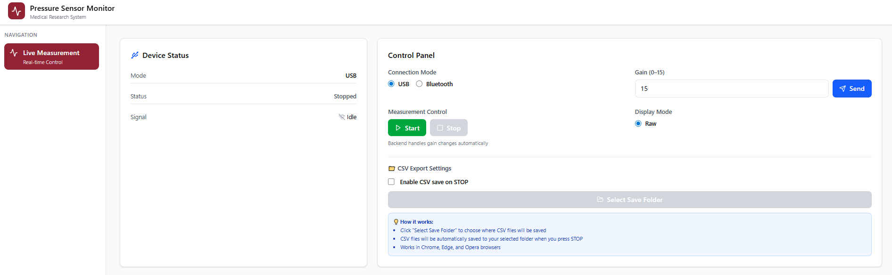
How to open the website ?
After both the backend and frontend services are running, open a web browser and navigate to: http://localhost:5173/live

Slide 13
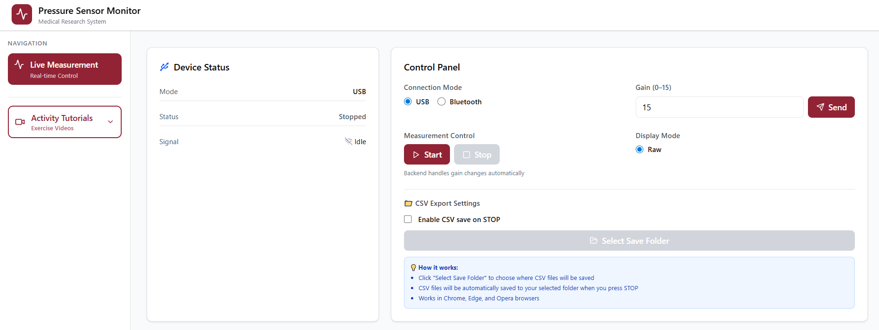
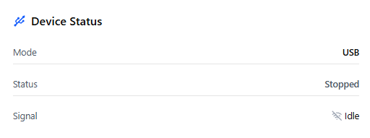
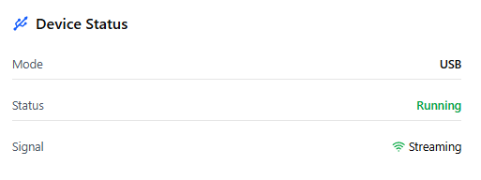
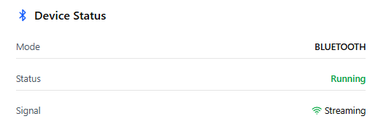
What inside the website ? – Device Status
The Device Status panel displays the current state of the sensor and measurement system.
Mode Shows the active connection mode (USB or Bluetooth).
Status
Stopped: Measurement is not running
Running: Measurement is active
Signal
Idle: No data is being streamed
Active: Sensor data is being received
This panel is read-only and updates automatically based on backend status.

Slide 14
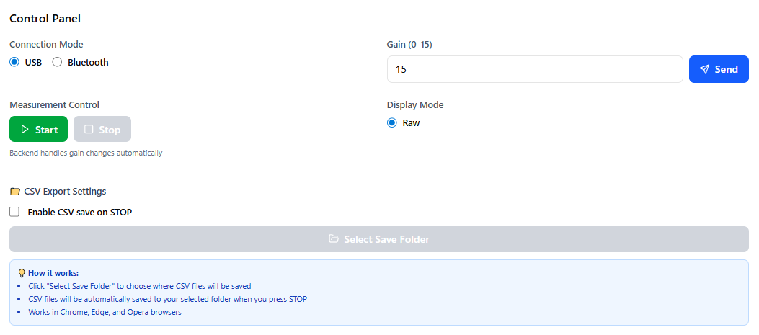
What inside the website ? - Control Panel
Connection Mode
Select USB or Bluetooth as the connection mode.
USB mode is recommended for stable and continuous measurements.
Bluetooth mode is optional and depends on device availability.
Start Begins real-time pressure measurement and data streaming.
Stop Stops the measurement and freezes the displayed data.
⚠️ Measurement must be started from this control panel. The system will not stream data unless the Start button is pressed.
Gain Setting
Gain (0–15) Enter the desired gain value and click Send.
Gain adjustments are handled automatically by the backend.
Higher gain values increase signal sensitivity.
Display Mode
Raw mode display pressure data directly from the sensor.(Currently the system only have 1 mode (Raw)
CSV Export Settings
This section allows automatic data saving when a measurement is stopped.
Enable CSV save on STOP
When enabled, the system automatically saves measurement data as a CSV file after pressing Stop.
Select Save Folder
Choose the destination folder for saving CSV files.
The selected folder will be used for all subsequent exports.

Slide 15
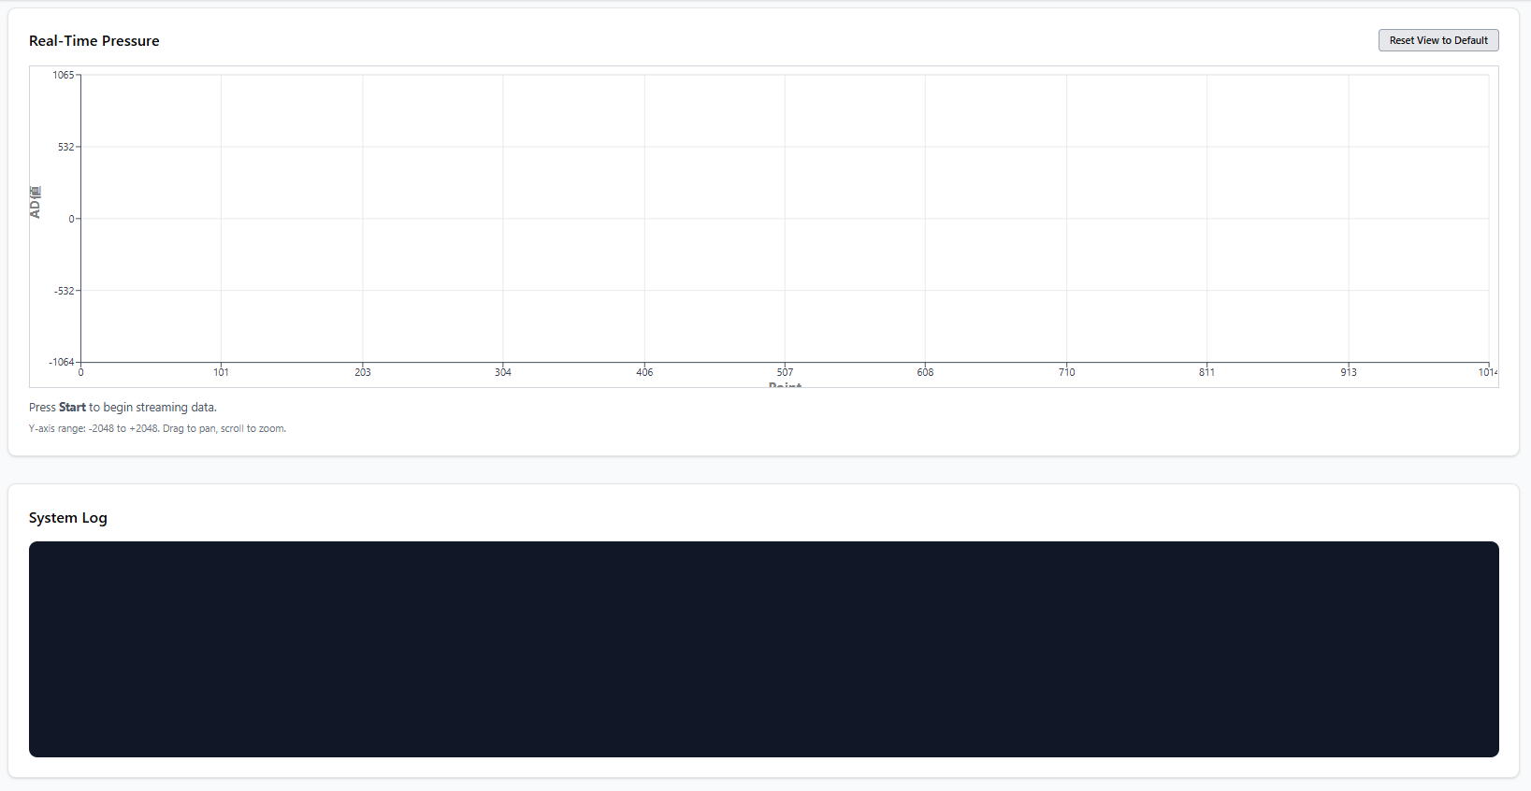
What inside the website ?
Real-Time Pressure Graph
Displays pressure data in real time during measurement.
The graph uses a sliding window:
New data appears continuously
Older data scrolls out of view
Reset View to Default
Resets zoom and pan to the default view.
Y-axis: ADC value X-axis: Sample index / time progression
System Log Panel
The System Log panel displays real-time system messages generated by the application. This panel is used to monitor system activity, user actions, and backend responses during operation.

Slide 16
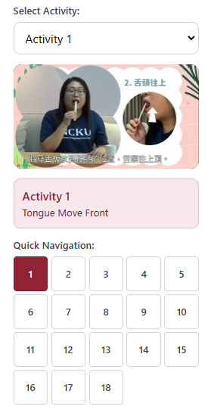
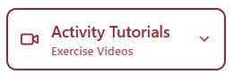
What inside the website ? – Activity Tutorials
Activity Tutorials
The Activity Tutorials section provides guided exercise videos that help users perform standardized the movement activities while using the pressure sensor system.
How to Access Activity Tutorials ?
Open the left navigation menu
Click Activity Tutorials
Select an activity from the Select Activity dropdown list.

Slide 17
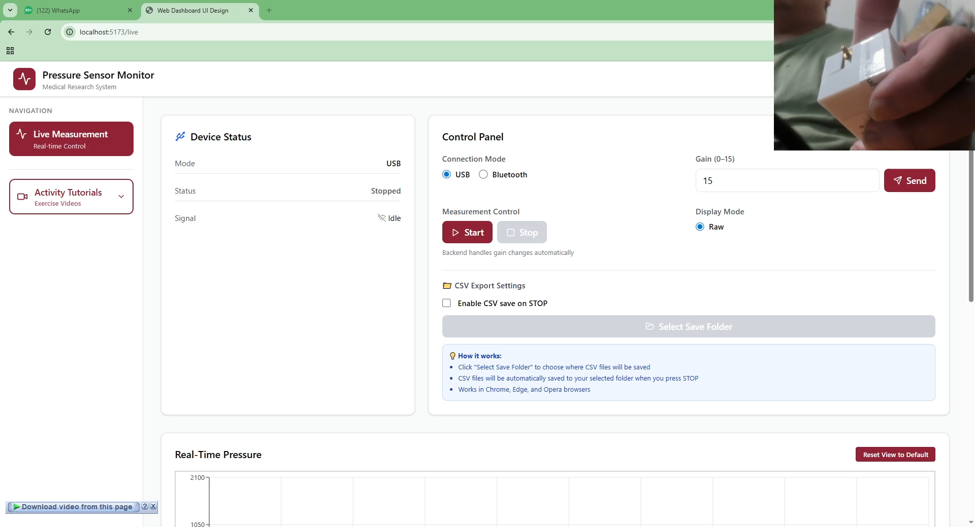
Live Measurement Demonstration (USB Mode)

Slide 18
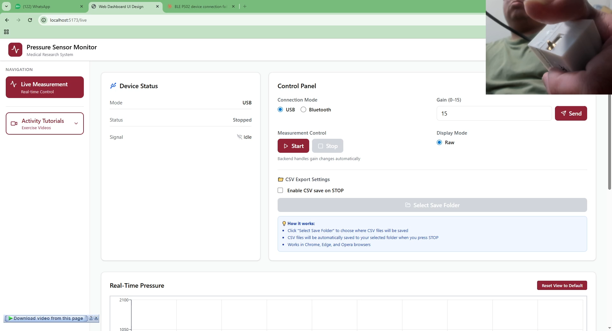
Live Measurement Demonstration (Bluetooth Mode)

Slide 19
謝謝 Thank You

